Slide 1
Boomi Enterprise Platform
The trusted platform for integration and AI-driven automation
“ The New”
Steve Westerman, Global Partner Enablement Lead

Slide 2
Discussion Topics
Key Business Objectives
Barriers to Success
Boomi Enterprise Platform
The Boomi Difference

Slide 3

Key Business Objectives
Accelerate Innovation
Manage agentic AI as a unified and governed enterprise-wide solution
Simplify and Save
Consolidate disparate platforms and tools
Minimize Risk
Ensure tools and platforms align with trusted 3rd party compliance and audit certifications
Notes:
Three of the most critical business objectives that will enable businesses to thrive in AI-driven era are:
Accelerate Innovation
Simplify and Save, and
Minimize Risk
Accelerate Innovation
Virtually every business is in the early phases of developing and deploying agentic AI. There is no question it is one of, if not the #1 most disruptive technology to both accelerate innovation, and at the same time, pose a huge risk of introducing very big challenges to the organization in terms of security, privacy, and AI hallucination.
As these challenges grow, at the same time, businesses need to simplify the platforms and tools they work with to streamline their path to the future. Over time, the number of platforms and tools spanning legacy middleware, API management, data management, and more has grown to the point where business can no longer scale the business while managing this complex mix of software. Likewise, this mix of disparate toolsets has driven up operational expenses to a record high as businesses are exploring solutions to consolidate tools into a solution that simplifies and unifies to save time and operational costs.
And finally, as Gartner (see source below) noted in January (2025), new digital transformation initiatives combined with the incoming wave of AI-driven demand for distributed data will increase the demand for integration by 10x in 2028. All this new integration will be reaching out to a much broader set of application and database endpoints, known as digital sprawl, leading to many new challenges including the need to minimize security risks, privacy risks, and other more.
Next, let’s take a deeper look at some of these challenges and what the path to success looks like
How Generative AI Is Impacting Integration Teams
14 January 2025 - ID G00806826 - 11 min read
By: Keith Guttridge, Andrew Humphreys
Strategic Planning

Slide 4
Barriers to Success
Accelerate Innovation
Barriers to Success
Tech debt maintenance
Legacy middleware
Lack of reuse
IT backlog
Simplify & Save
Barriers to Success
Inability for IT to democratize
Too many disparate tools
Lack of low-code solutions
High licensing costs
Minimize Risk
Barriers to Success
Excessive security entry points
Ungoverned shadow APIs
Weak security compliance
Quality of SLA
Notes:
So why in 2025 have companies not achieved these key business objectives? Let’s take a look at the barriers to success:
Accelerate Innovation (key barriers to success to highlight):
Tech debt: 40% of IT budgets are consumed by technical debt, which limits the ability of companies to spend on innovation. Source: Forrester: Predictions 2025 - Automation by Craig Le Clair, et al. - Oct, 2024
Legacy middleware: According to Gartner, 43% of companies are still using on-premises middleware (Gartner calls “Application Integration Software”). Most vendors of these solution no longer add innovation into these solutions as they invest in cloud-native PaaS software.
Lack of Reuse - Although many companies want to transition to a composable solution (assembling existing components), their tools and platforms are not designed to enable these strategies
Simplify & Save (key barriers to highlight)
Likewise, “democratization” is easiest to deploy when a platform has multi-tenant inheritance (as Boomi has) so IT can create top level implementations that can be push down the hierarchy.
Too many disparate tools is a key challenge and we’ll cover this in more detail
High licensing costs, often as a result of underutilized on-premises middleware
Minimize Risk: (key barriers to highlight)
The more fragmented the application infrastructure and the more fragmented the tools that attempt to connect and automate that infrastructure, the more opportunities for security breaches.
Ungoverned “shadow APIs” - 68% of all participants knew that they had shadow APIs. - State of API Security by Imperva (2024)
Weak security compliance (comparison table of security compliance is included down in “The Boomi Difference” section

Slide 5
Attempting to Solve Digital Sprawl
With an accumulation of tools and platforms
SaaS Applications
App Integration Tool
Data Integration Platform
SaaS-embed Integration Tool
API Management Tool
Data Management Platform
Legacy Middleware
Legacy ETL Tool
Legacy API Management Tool
API Management Tool
Legacy EDI Tool
Acquired companies
Headquarters
Additional offices
Notes:
This slide illustrates a common problem many organizations face: the accumulation of disparate integration and automation tools over time. This often happens as companies grow, acquire other businesses, or as different departments choose their own preferred solutions. While each tool might serve a specific purpose, the overall landscape becomes fragmented, leading to increased costs, complexity, and inefficiencies.
As you can see, there are multiple tools for similar functions. This overlap creates redundancy and confusion. IT teams struggle to manage and maintain these various systems, leading to higher operational costs and slower response times. For example, a company might have multiple API management tools, each with its own unique interface and processes. This makes it difficult to establish consistent policies and security measures.
Another challenge is that these disparate tools often don't integrate well with each other. This creates data silos and hinders the flow of information across the organization. As a result, businesses struggle to gain a holistic view of their operations and make data-driven decisions.
In the following slides, we'll delve into the negative consequences of this digital sprawl and how Boomi provides a unified solution to address these challenges

Slide 6




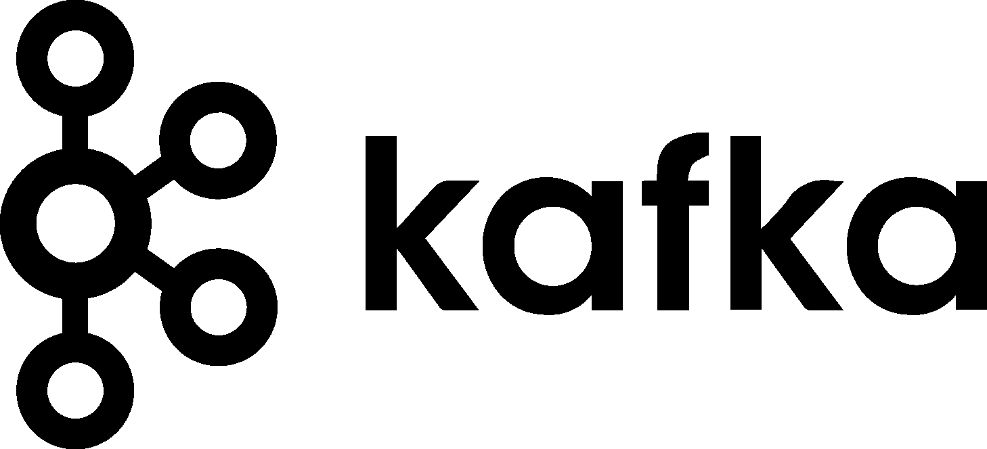
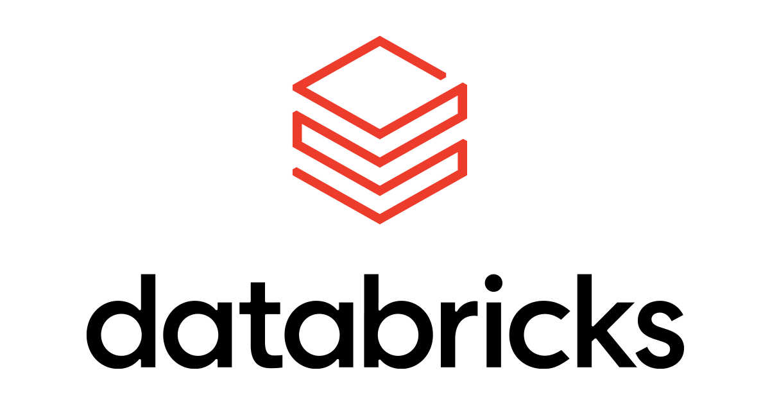












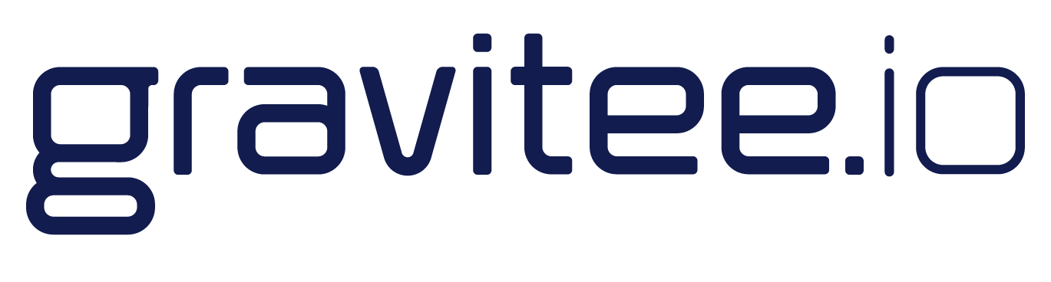





AI-driven Digital Sprawl
Application Sprawl
API Sprawl
Data Sprawl
AI Sprawl
360
Applications
600
APIs
1,000
Data Stores
500+
AI Agents by 2028
‹#›
Notes:
Digital Sprawl has accelerated growth of endpoints throughout the business to the point where it's a roadblock preventing businesses from achieving their AI and innovation goals.
For integration and automation it used to be about application sprawl. in the integration and automation area, that used the be the primary focus of sprawl with, the average Enterprise now having over 360 applications.
But now, API sprawl has accelerated the requirement to gain control over a growing collection of APIs, now over 600 on average for enterprises, from your SaaS apps, your on-premise apps as well as what your Dev team is creating . In addition to the growing number of APIs, the other API challenge is that there is also API Gateway sprawl. It's no longer the case where businesses have just one API gateway such as AWS or Azure. Now more and more Enterprises are having multiple gateways, resulting in a lack of visibility across the entire API ecosystem.. And finally…
Data sprawl. There's such concern about getting quality data out of AI we've all heard about GenAI hallucinations so it's important that we get control over the data sprawl within our business, make sure that's cleansed and trusted data so we can use that to ensure we are integrating and automating on top of trusted data and this data and services can be accessed with APIs managed across a distributed API solution.
And finally, the incoming wave of AI sprawl:
AI Sprawl: Key Factors Driving AI Agent Deployment Growth:
1. Current AI Adoption Trends
· As of 2024, enterprises already use AI in customer service, analytics, and automation.
· The 2023 McKinsey AI Report suggests a 30-40% CAGR in AI-powered automation adoption.
2. Gartner’s Projection
By 2028, 33% of enterprise software applications will include AI agents.
· Large enterprises use hundreds of business applications, meaning a significant portion will be AI-enabled.
3. Types of AI Agents Expected in Enterprises:
· Customer Support Agents (AI-powered chatbots, voice assistants)
· IT & Security Agents (AI for monitoring, cybersecurity response)
· Marketing & Sales Agents (AI-driven personalization, automated outreach)
· Finance & HR Agents (automated decision-making, document processing)
· Supply Chain & Operations Agents (predictive logistics, AI inventory management)
4. Enterprise Size & AI Agent Growth by 2028:
· Small to Medium Enterprises (SMEs): Likely 10-50 AI agents
· Large Enterprises: Likely 100-500 AI agents
· Tech-Forward Enterprises (AI leaders): Could exceed 1,000 AI agents

Slide 7
The Solution

Slide 8
A Unified Platform
to
Connect Everything
Integration | API Management | Data Management | AI Management
Notes:
The solution is a unified platform to connect everything. Bringing together the 4 key pillars required for AI-driven automation.

Slide 9
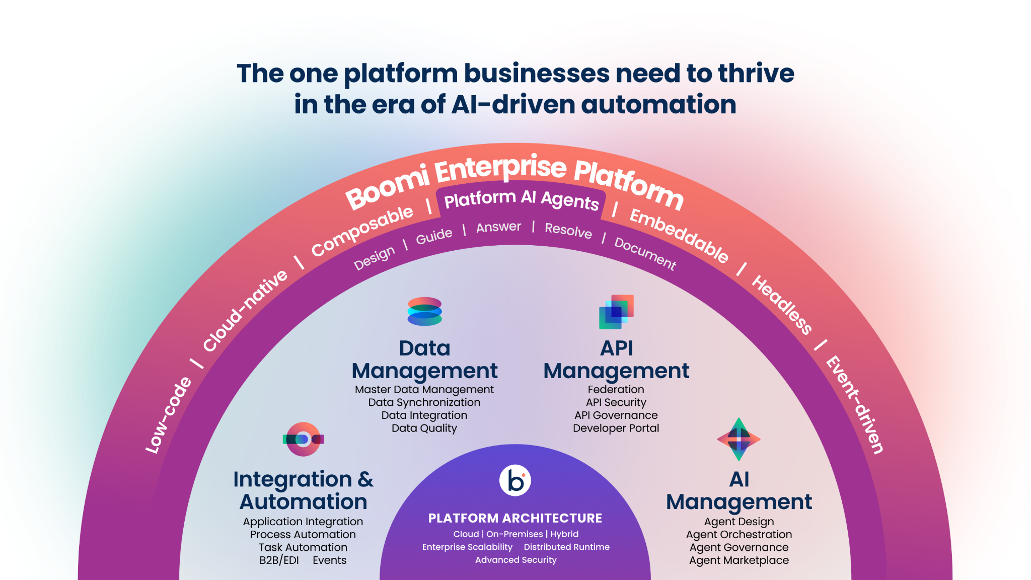
Notes:
This is the Boomi Enterprise Platform…the one platform businesses need to thrive in the era of AI-driven automation. Customers can integrate applications, data, APIs, and even AI Agents. While it provides end to end capabilities, you can start wherever you need:
Integration and Automation is the foundation for creating frictionless processes that span applications by providing prebuilt connectivity and intelligent workflows. And, as the pace of agentic AI continues to accelerate, it’s critical to have a platform that can easily incorporate agents into existing and new business process automations without barriers.
Historically, Data Management was seen as separate from application integration and automation. But in the AI era, it’s more critical than ever to make data management a core part of ensuring the data you integrate and automate is trusted and reliable.
APIs play a critical role in the AI era by enabling seamless access to data, models and services across applications and platforms. With the explosion of APIs it’s critical to have a cloud-scale API Management solution that helps discover and govern all APIs and is accessible to the same team providing integration, automation, and data management.
And finally, most companies are in the early stages of building and deploying AI agents. As this trend accelerates, agent sprawl will occur if left unchecked. Boomi’s AI Management solution prevents AI agent chaos by providing orchestration and governance of all AI agents - from Boomi and beyond
To drive hyperproductivity, the platform includes built-in AI Agents that automatically handle common tasks such as creating and documenting integrations and APIs.
All of this comes from the only platform recognized as a leader in every Gartner Magic Quadrant for Integration Platform as a Service since its inception.
Key reasons why customers choose the Boomi Enterprise Platform are:
Low-Code: Boomi’s development approach that removes the complexities of code-centric development.
Cloud-Native: Runs and scales efficiently in cloud environments by leveraging containerization, microservices, and dynamic orchestration.
Composable: Built with modular components that can be easily assembled, reused, and reconfigured so you never start from scratch..
Embeddable: Built to be OEM-ready, allowing functionality to be embedded within other systems.
Headless: Boomi can be used as a system that operates without a user interface, exposing its functionality via APIs for flexible front-end implementation.
Event-Driven: The platform is architected to respond to real-time triggers and asynchronous events, enabling responsive and scalable workflows.
And all of this is built upon a highly scalable platform architecture that can be deployed in the cloud, on-premises, or a hybrid combination of both, with advanced security required to ensure your data remains secure.
So… to summarize, the Boomi Enterprise Platform, regardless of the entry point, Integration & Automation, Data Management, API Management, or AI Management, provides the one platform businesses need to thrive in the era of AI-driven automation, by connecting everything. Companies now have a future proof path to address near-term goals as well as ensuring the incoming wave of digital sprawl and AI chaos are managed so the business can focus on accelerating innovation.

Slide 10
Key Capabilities
Integration & Automation
API Management
Data Management
AI Management

Slide 11
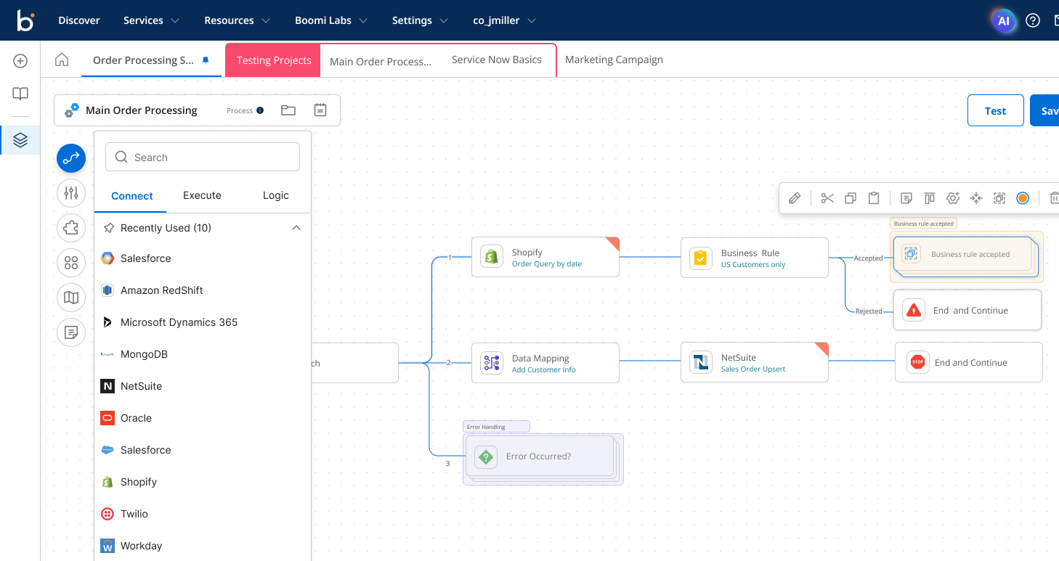
Boomi Integration & Automation
Integration & Automation
API Management
Data Management
AI Management
Connect and automate applications, data sources, devices, and people
Rapidly connect using an intuitive visual drag-and-drop interface with pre-built recipes, blueprints, and artificial intelligence.
KEY CAPABILITIES
Pre-built Connectors and Recipes - Over 600 ways to jumpstart your integration and automation
AI-Driven – Conversationally build your integrations and leverage embedded agents for answers and more
Seamless Access to Adjacent Services – Easily extend your integrations with human form integration, trading partner collaboration (EDI), and more
Composable Reuse– Leverage inherent composability to never start from scratch
Democratize Development – Enable IT to build “safe spaces” for non-specialists to develop
READY
‹#›
Notes:
Rapidly connecting applications and other data sources is often how businesses launch a new digital transformation strategy. The #1 mostly highly rated “Like” of Boomi in the G2 review site is “Ease of Use” and is a result of a continued focus on simplifying the user experience with pre-built connectors, recipes, and embedded AI-driven enhancements.
Pre-built Connectors and Recipes: Instead of custom coding the specification of every application you connect to, boomi has done that work for you. Simply configure the connections and start with any prebuilt recipe that aligns with your next business initiative.
AI-Driven - We’ll take a look into some of the new AI-driven integration capabilities that provides guidance on creating integration, answering questions, and AI-driven problem resolution.
Seamless Access Adjacent Services (if including the slide from the API section showing the common UI across applications, mention you will share that slide later, otherwise, include it in this section) Boomi is built up on a common user experience and has shared platform security, privacy, and reliability capabilities that are leveraged for every cross-platform solution
Composable Reuse - We’ll look at some of the capabilities in the platform help you create projects leveraging existing work you have done before. Encapsulating project components for reuse.
Democratize Development - Remove the IT bottleneck by using Boomi Enterprise Platform capabilities that are designed to enable IT to simplify development so business technologists in LoBs can contribute.

Slide 12
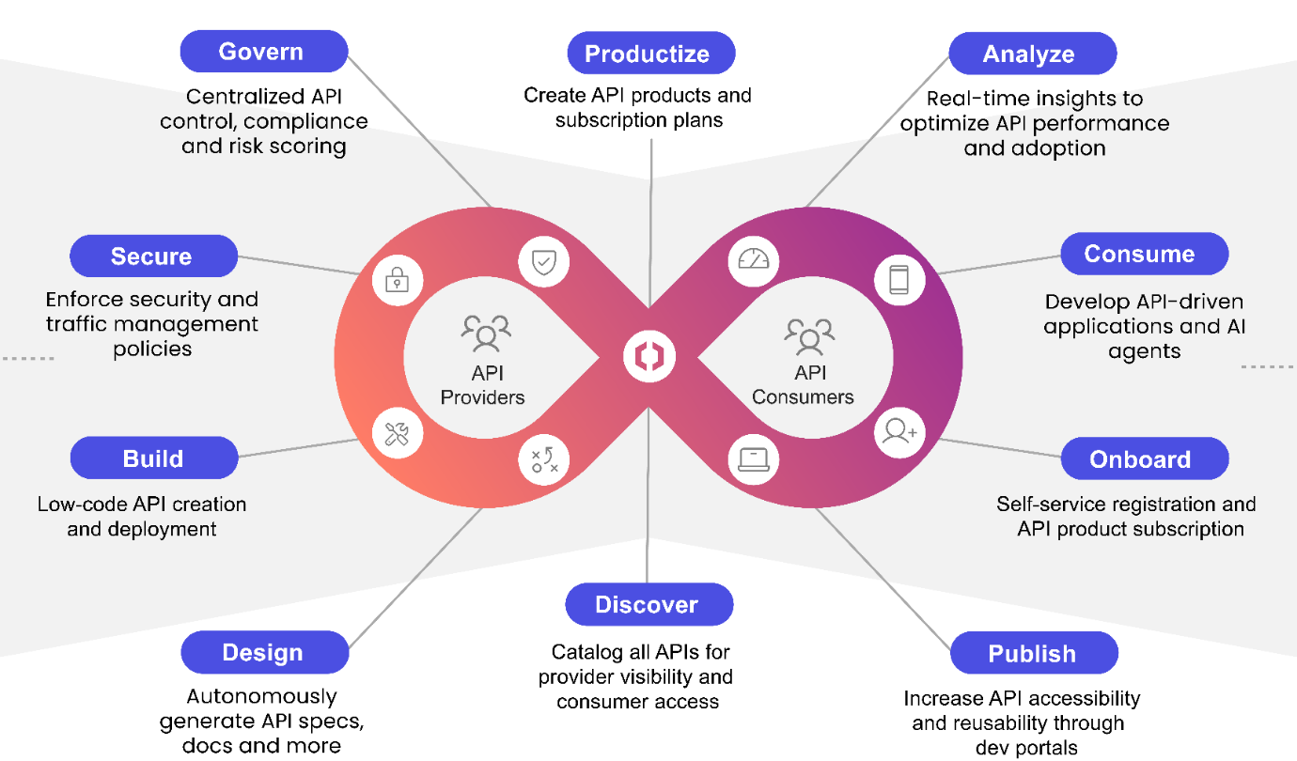
Boomi API Management
Transform APIs into growth engines. Tame API sprawl, scale securely, and innovate boldly.
Integration & Automation
API Management
Data Management
AI Management
Comprehensive API Management with robust security, traffic control, dynamic policy enforcement, all with flexible deployment options across Boomi, cloud, and third-party gateways. GenAI-driven features accelerate API management processes.
Key Capabilities
AI-Powered Productivity – Accelerate time-to-market and boost developer productivity with support from AI agents for APIM processes
Federated API Control – Unify APIs across your landscape for centralized control, including increased adoption and reusability for a greater return on your asset investments
Governance and Security – Transform data, applications, and AI into secure APIs to confidently drive innovation
Flexibility and Scale – Power mission-critical applications and AI workflows, deploy anywhere with zero overhead, focus on innovation not infrastructure
Unified Platform – Combine powerful APIM with market-leading integration and automation, data management, and AI capabilities
Conquer API Chaos and Unleash Business Potential
‹#›
Notes:
Boomi's API Management offers a comprehensive approach to transforming API management for better security, control, and into a growth engine for your application services. Key features include AI-powered productivity, which accelerates time-to-market and enhances developer efficiency through AI agent support. The federated API control unifies APIs across various landscapes, ensuring centralized management and increased reusability. Governance and security are emphasized, allowing the transformation of data, applications, and AI into secure APIs, fostering innovation with confidence. The platform's flexibility and scalability support mission-critical applications and AI workflows, enabling deployment anywhere without infrastructure concerns. The unified platform combines powerful API management with leading integration, automation, data management, and AI capabilities. Elements include the API lifecycle, from design and build to governance, security, and consumption, ensuring a seamless API management experience for providers and consumers.

Slide 13
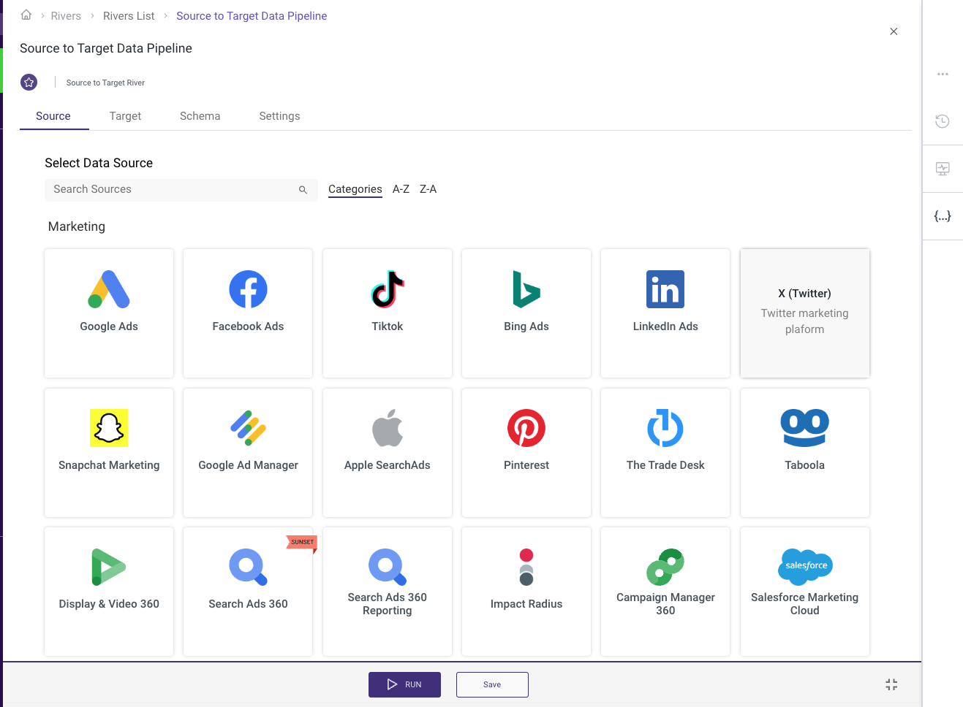
Boomi Data Management
Integrate and govern all of your data at scale. Deliver trusted data for analytics and AI
Integration & Automation
API Management
Data Management
AI Management
Centralize and manage the organization critical business data across multiple systems. Leverage the cloud elasticity and no-code to deliver it with ease and speed.
Key Capabilities
A modern data integration platform - Make complex data integration simple and easily scale data delivery for analytics and AI.
Accelerate data prep - Shorten time-to-insight using workflow templates with data models and orchestration logic built in.
Trusted data to drive decisions- Single source for trusted high quality, enterprise ready data to support informed business decisions.
Secure sensitive data – Encrypt and protect sensitive data residing inside DataHub.
Get data AI-ready – Build an AI-ready foundation with high-quality, trusted data and enforce data governance practices.
Synchronize data across sources – Reduce data fragmentation with a bi-directional flow of high-quality, accurate data.
Your foundation for trusted data
‹#›
Notes:
Centralizing critical business data and leveraging cloud and no-code tools offers immense advantages. Boomi provides a combination of elasticity, scalability, and speed enhances your organization's ability to manage, analyze, and act on data across multiple systems.
We do this by:
Simplifying Complex Data Integration
The Challenge of Data Integration:
Companies today pull data from multiple sources—databases, APIs, cloud services, on-prem systems, etc.
Integrating these diverse data sets into a cohesive, usable format for analytics and AI is complex, time-consuming, and resource-intensive.
Boomi Solution:
A modern data integration platform simplifies the process, enabling users to easily integrate data from disparate sources without the need for extensive coding or manual processes.
Seamlessly connect and centralize data to ensure faster insights and improved decision-making.
Accelerating Data Preparation
Speeding Up Time-to-Insight:
Data preparation is often one of the most time-consuming steps in the analytics and AI process.
Use of pre-built workflow templates that include common data models and orchestration logic reduces the time spent on setup.
Ready-to-use templates streamline data transformations, clean-up, and quality checks, allowing teams to focus more on analysis rather than prep.
Boomi Outcome:
Shorten time-to-insight and boost productivity with faster data readiness and quicker access to actionable insights.
Trusted Data for Informed Decisions
The Importance of Trust in Data:
Inconsistent, inaccurate, or fragmented data can lead to poor decision-making and missed opportunities.
Trustworthy, high-quality data is essential for making informed business decisions.
Single Source of Truth:
A modern data integration platform consolidates data into a single source of truth.
Data is cleansed, validated, and standardized to ensure consistency, accuracy, and readiness for decision-making at all levels.
Boomi Result:
Empower data-driven decisions with confidence, knowing that the data you're using is reliable and enterprise-ready.
Secure Sensitive Data
Data Security Challenges:
Organizations must protect sensitive data from breaches and ensure compliance with regulations like GDPR, HIPAA, etc.
Traditional methods of securing data often create barriers to data accessibility or slow down the integration process.
Solution:
The platform provides built-in encryption and robust security features to safeguard sensitive data, both at rest and in transit.
Secure sensitive data while maintaining the ability to access and utilize it for analytics, AI, and decision-making.
Boomi Outcome:
Protect critical data assets while ensuring seamless access for authorized users and applications.
Get Data AI-Ready
Preparing Data for AI:
High-quality, trusted data is the foundation of effective AI and machine learning models.
Without proper data governance, AI models can produce biased, inaccurate, or unreliable results.
Building an AI-Ready Foundation:
The platform ensures that data is curated, cleaned, and aligned with best practices for AI, offering a high-quality, trusted dataset for training and deployment.
Enforce robust data governance practice to ensure that AI models are built on reliable, ethically sourced data.
Boomi Outcome:
Enable the development of AI models that produce actionable insights and support informed business decisions.
Synchronize Data Across Sources
Data Fragmentation:
Data silos are a common challenge where critical information resides in separate systems, causing fragmentation.
Inaccurate or outdated data across systems can lead to inconsistent results, reporting errors, and missed opportunities.
Solution:
The Boomi platform supports bi-directional data flow to synchronize data across multiple systems in real-time.
Ensure that all connected data sources reflect the same, accurate, and up-to-date information.
Boomi Outcome:
Reduce data fragmentation and ensure that every system is using the most current, consistent, and accurate data for business processes.
In conclusion, Boomi Data Management simplifies complex data processes, accelerates data prep for analytics and AI, and ensures data quality and security. It allows businesses to make data-driven decisions based on trusted, high-quality, and secure data leveraging a single platform to synchronize data across systems and get data AI-ready which positions your organization for long-term success in the data-driven world.

Slide 14
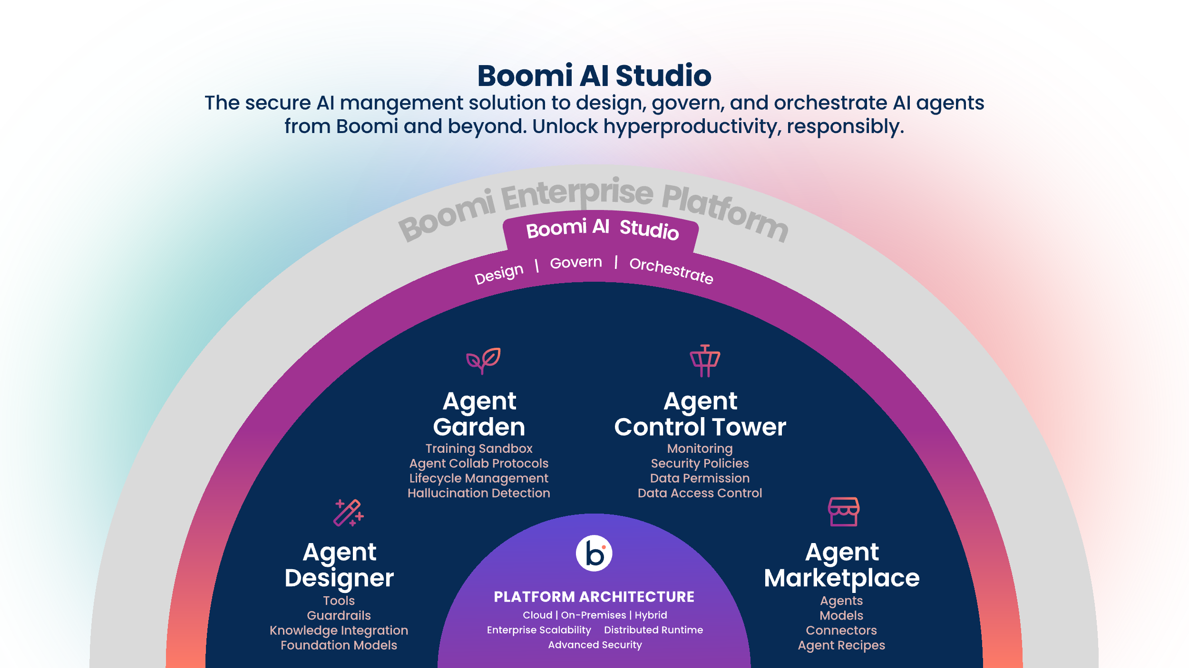
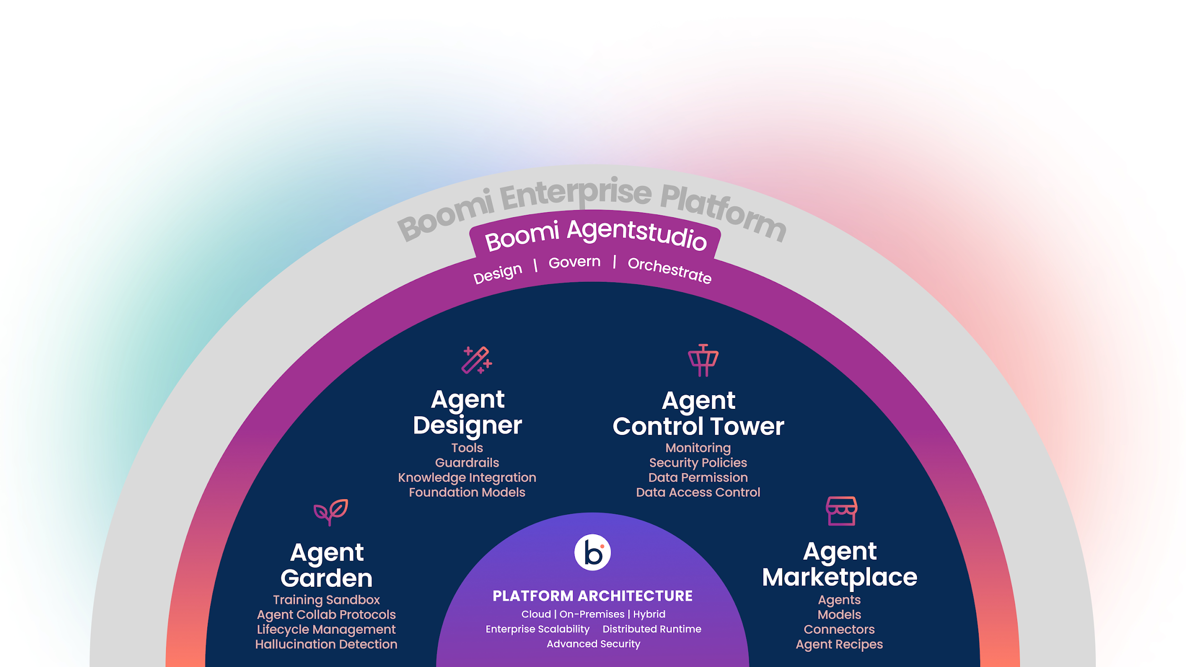
Boomi Agentstudio
The only platform to deliver full agent lifecycle management.
Design, govern, and orchestrate all AI agents at scale to unlock hyperproductivity, responsibly.

Slide 15

Boomi Agentstudio
The only platform to deliver full agent lifecycle management.
Design, govern, and orchestrate all AI agents to unlock hyperproductivity, responsibly.
Design AI agents with
confidence and control
Simply design unique AI agents to conquer any task for anyone, anywhere
Embed ethical guardrails in every AI agent, making responsible AI a priority
Ground AI agents in trusted enterprise data and knowledge
Govern AI to prevent
agent sprawl
Centrally manage AI agents from Boomi and beyond
Monitor AI agents and control access to reduce risk
Safeguard against costly AI security failures
Orchestrate
frictionless business
Integrate AI agents into every business process to drive hyperproductivity
Enable AI agents to collaborate on complex processes for maximum impact
Accelerate AI innovation with proven agent use cases

Slide 16
Putting it all together

Slide 17
The Digital Journey
Accelerate your path into an AI-enabled integrated and automated future
Digital Transformation
5
2
3
4
Market
Leadership
(your Future)
1
Digital
Fragmentation
(Today)
Readiness
Connect
Automate
Develop AI Readiness plan
Expand dev team with Democratization
Composability for reuse where relevant
Integrate Applications
Synchronize and cleanse data
Get control across disparate APIs
Deploy AI on top of trusted data, using managed APIs on top of connected systems
Optimize AI-enabled integration and automation for massive scale
Technology
API, Application, and Data Sprawl
Deliver amazing experiences
Seize new opportunities
Accelerate market share growth
Now has a clear vision for the future
Key business processes now faster
Higher customer satisfaction
Full deployment of non-optimized AI across applications and people
Business
Slow
Reactive
No cohesive strategy
Notes:
The path to Digitally Transform is a journey. It’s got to be fast, but it doesn’t happen overnight. Here are some key steps and milestones along the way to consider:
Digital Fragmentation is where most companies are today. More APIs and applications than can be connected and managed manually and data sprawled out over many data sources with questionable data quality.
A first steps is “Readiness”, “AI Readiness” is a key component to plan your way to an AI enabled future to prevent too many starts & stops until you stumble your way there. Readiness in terms of how develop your democratization plan to shift IT over to enablers of tech for business technologists and composability planning to figure out where reuse makes sense and where it doesn’t (more cost in making it reusable with little reuse expected)
Connect – is where you begin to leverage pre-built and composable tools for your first high profile transformation projects, where you synchronize data in the context of integration & automation, and where you deploy a control plane across disparate API gateways.
Automate – layers AI and workflow automation on top of your connected and often AI-enabled services.
Market Leadership – is your end goal. What you become if you are fastest with this journey.

Slide 18










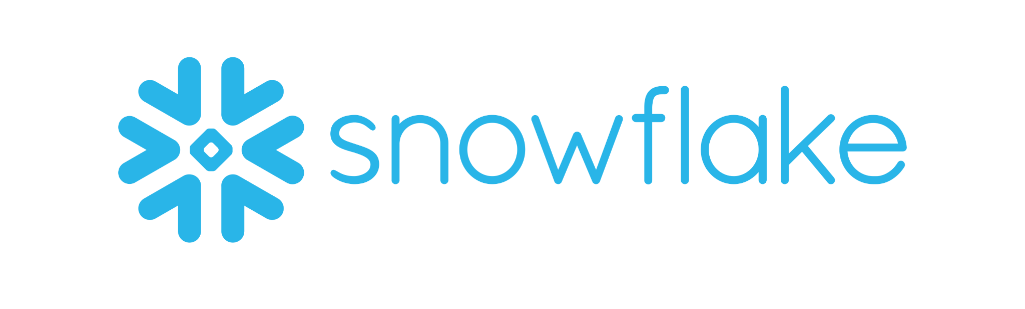
Enterprise Platform Expansion Play
API Management
AI Management
Inventory Optimizer Agent
Set Price API
API Control Plane
Dynamic Pricing Agent
Agent Control Tower
Product Image API
Integration & Automation
Data Management
Netsuite-Shopify Integration
Adjust Price Process
Order DataHub
Snowflake Pipeline
Enterprise Data Lake
Notes:
This architecture diagram shows how each pillar of the Boomi platform was used to deliver discrete business value for Starlight, but even more impressively how the pillars combined to provide transformative business value that is greater than the sum of its parts.

Slide 19
The Boomi Difference

Slide 20
The Boomi Difference
23,000
Customers
250,000
Community
300,000,000
Integrations indexed for Boomi AI
Notes:
With over 23,000 customers, no other integration and automation solution provider has the same level of expertise and embedded best practices as Boomi. After beginning your path to digital transformation, leverage the insights and collaboration of 250,000 community members in the Boomiverse to get answers to your questions and learn from those who have implemented solutions that are at the beginning of your journey.
And finally, with over 300M integrations that our AI draws from, you can be assured your path to meet your future goals are well underway with a partner with a proven and trusted solution provider.

Slide 21
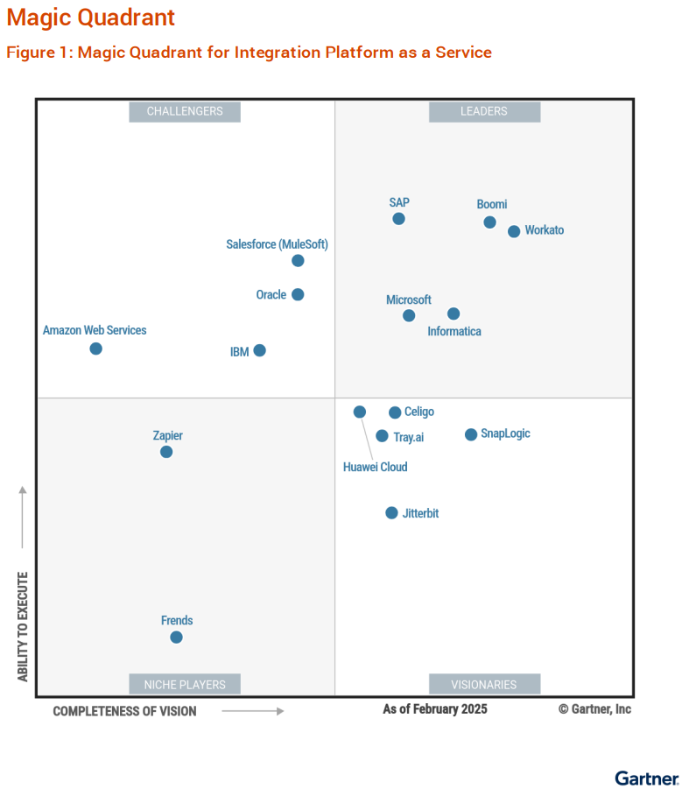

This Year’s
Gartner Magic Quadrant
Released May 21st, 2025

Slide 22
The Boomi Difference
Agentic AI Innovation
Highest Ability to Execute
Deep investments in agentic AI design, management, and governance built upon a foundation of being the first to introduce AI/ML for integration & automation
Placed as “Highest Ability to Execute” in the Gartner® iPaaS Magic Quadrant™ Worldwide 2025. More customers than any other cloud integration provider
Future Proof Platform
Flexible Deployment Options
Complete support for your growing integration, automation, API management, data management, and AI management needs
Hybrid deployment to run anywhere – in the cloud, on-premises, or at the edge
Enterprise Scalability
Security, Privacy & Compliance
Deliver extreme throughput scalability and provide organization scalability for democratization
FedRAMP, SOC 1/2, ISO 27001, StateRAMP, HIPAA and more for enterprise-grade security and reliability
Notes:
To achieve these business outcomes of agility, lower TCO, and speed fast enough to achieve your goals, there are 6 reasons why Boomi offers a better value proposition than any other competitors in the market.
The first is “AI Innovation Leadership”. As validated by key industry analysts, Boomi is the leader in AI innovation for integration & automation
Enterprise Scalability – Lyft gave a session at the 2024 Boomi World conference where they spoke about their 20M – 50M transactions per day.
Ease of Use – Along with speed, the most common aspect of feedback when review sites ask ‘what do you like about Boomi”
Highest Ability to Execute – Boomi is the only integration platform vendor that has been a leader for all 9 years of the Gartner iPaaS Magic Quadrant. And the reason that is so important is because it has given us 10 years of experience and expertise in migrating from legacy middleware solutions such a webMethods and home-grown integration and more.
Flexible Deployment might not seem like it’s a top 6 differentiator, but customers later realize it can be a huge benefit for them. Data sovereignty requirements might arise that require you to migrate to a hybrid deployment, including some aspects running on-premises. Boomi uniquely lets you run the full runtime, not just “on-premises agents” for connectivity, but the whole runtime.
Privacy, Security, and Compliance – Boomi has extensive certifications. Many vendors in the space do not have this broad of a list (including FedRAMP) and even companies outside of federal government (for example) can benefit by knowing we meet extensive requirements.
So you never get dead-ended in your journey by a limited solution or mired down in tech debt with a complex dev-centric solution. Future proofing with the all of the speed you need combined with the ability to support whatever might come next. These make up the Boomi difference.

